Slide 1
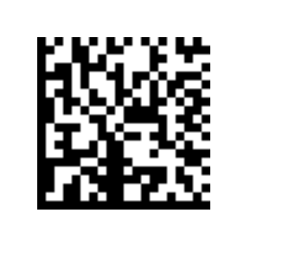
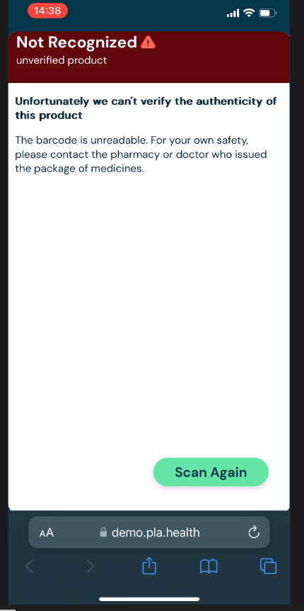
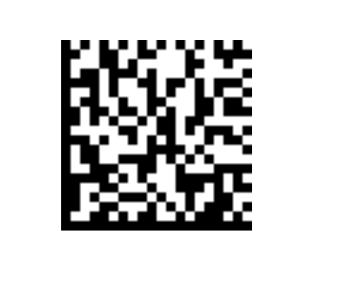
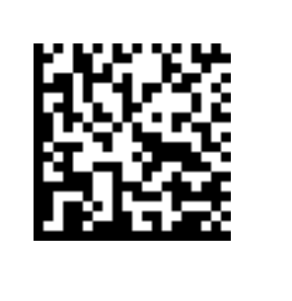
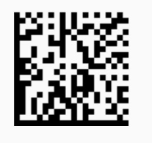
Use this for scenarios 1 - 5
Scenario1:
GTIN not created in EW
Scenario2:
GTIN error, only 13 digits
Scenario3:
GITIN error, check digit wrong
Scenario5:
XML error
‘Not Recognized’ -> ok
Remove ‘Unverified Product’
Change to ‘This product cannot be found’
Delete text. Instead add:
Error code 001
(which codes to use, see below)
For technical team only:
001: product not available
002: GTIN cannot be decoded (too short)
003: GTIN check digit
004: network is too slow
005: invalid XML or error in browser

Slide 2
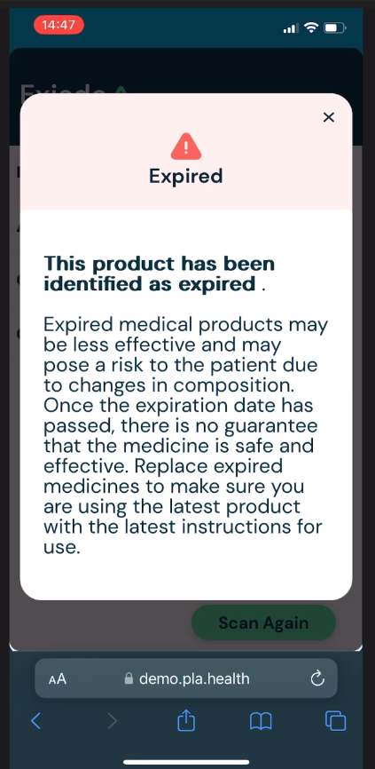
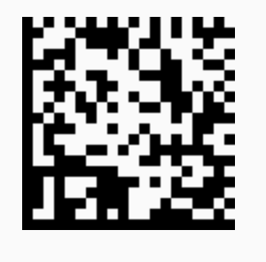
Use this for scenarios 6
Scenario6:
Product expired
EXP in barcode in the past
Okay
Okay
remove for MVP1

Slide 3
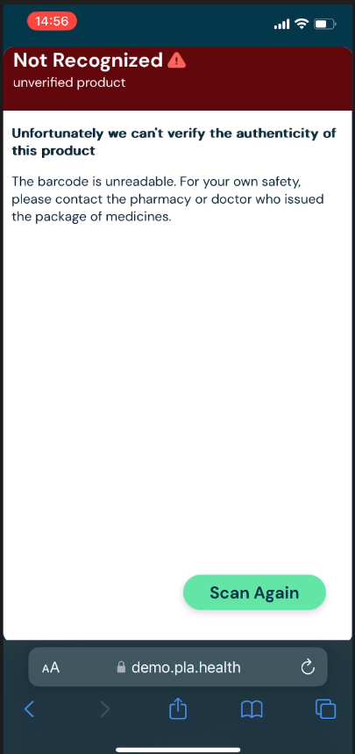
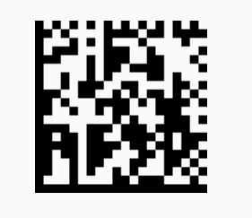
Use this for scenarios 7
Change ‘not recognized’ to ‘Product Information not Available’
Scenario7:
Product exists in EW but there is no
ePI uploaded
Remove ‘unverified product’
Replace with ‘Unfortunately, no product information has been loaded’
Remove this text

