Slide 1
OccO: The Occupation Ontology
Bridging Occupation Standards
John Beverley
University at Buffalo
Matthew Diller
William D. Duncan
William R. Hogan
University of Florida
Sam Smith
Yongqun “Oliver” He
University of Michigan
John Judkins
Jie Zheng
University of Pennsylvania
Robin McGill
Alabama Commission on
Higher Education

Slide 2
Outline
Motivation: Linking Occupation Data
Hallmarks of Occupation
Ontological Representation of Occupation
Applications

Slide 3
Outline
Motivation: Linking Occupation Data
Hallmarks of Occupation
Ontological Representation of Occupation
Applications

Slide 4
Big Occupation Data
Suppose you’ve recently been fired for giving a bad talk about occupation ontologies...
Current labor market trends can help you make informed decisions about future employment
Labor market data sources are varied, as are formats in which data is represented

Slide 5
Occupation Standards
The International Standard Classification of Occupations (ISCO) and the Standard Occupational Classification (SOC) are two major occupation coding standards
O*NET – in the United States - is based on SOC
The European Skills, Competencies, Qualifications, and Occupations (ESCO) is a European Union standard based on ISCO
Notes:
ESCO works as a dictionary, describing, identifying and classifying professional occupations and skills relevant for the EU labour market and education and training.
ESCO provides descriptions of 3008 occupations, translated into 28 languages (all official EU languages plus Icelandic, Norwegian, Ukrainian, and Arabic).
The aim of ESCO is to support job mobility across Europe by offering a “common language” on occupations and skills that can be used by different stakeholders on employment and education and training topics.
The O*NET database contains hundreds of standardized and occupation-specific descriptors on almost 1,000 occupations covering the entire U.S. economy. The database is available in English and Spanish, and is continually updated from input by a broad range of workers in each occupation. Every occupation requires a different mix of knowledge, skills, and abilities, and is performed using a variety of activities and tasks. Based on the U.S. SOC, the O*NET-SOC taxonomy currently includes 923 occupations which currently have, or are scheduled to have, data collected from job incumbents or occupation experts. This linkage between O*NET and the SOC links O*NET descriptive information to quantitative information on occupational employment, wages, and other variables from surveys conducted by the U.S. Department of Labor, Bureau of Labor Statistics.

Slide 6
Occupation Standard Limitations
These occupation standards largely cover the same domain, yet with respect to represented occupations they differ in:
  Metadata attributes
  Skills associated with ovelapping occupations
  Descriptions of basic tasking
Creating mappings – or crosswalks – between occupation standards has been a common way to promote interoperability

Slide 7
Traditional Crosswalks
Crosswalks bridge occupations in one standard to those of another, but have traditionally suffered from serious limitations:
    Loss of granularity across standards
    Outdated after updates
    Involve significant manual curation
    Incomplete across standards
Recently, NLP strategies have been leveraged to address some of these limitations
Notes:
A bridge between ESCO and O*NET is particularly useful for researchers and public officials, who are involved in developing policies to improve the labour market, or carrying out research on topics related to workforce and education.
Software engineer is parent of data scientist and cyber scientists in A, but only the latter two classes exist in B. That’s a granularity issue.

Slide 8
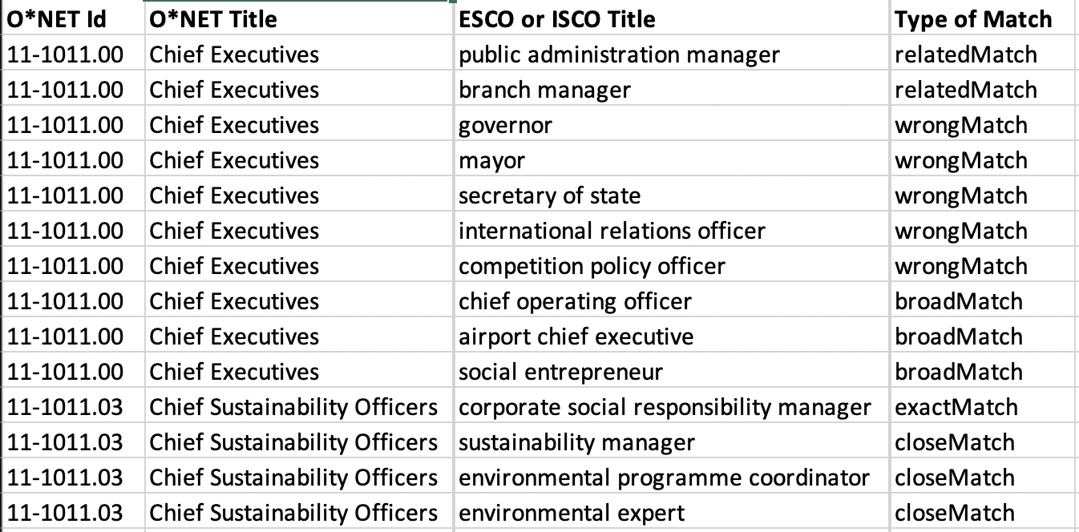
NLP-Driven Crosswalks
For example, a 2022 European Commission technical report describes a BERT model-based crosswalk from the ~3000 ESCO occupations to the ~1000 O*NET occupations, resulting in 7385 matches
Matches were determined
based on semantic
similarity scores between
occupation labels and
occupation descriptions
Notes:
The Jaccard coefficient only considers whether the same words appear in each text, not whether those words are used in a similar way or have a similar meaning.
For example, if two documents use completely different words to describe the same concept or idea, the Jaccard similarity will be low, even though semantically the documents might be very similar. Conversely, if two documents use many of the same words but in completely different contexts, the Jaccard similarity might be high, even though semantically the documents are quite different.
The distinction between syntactic and semantic similarity is not always clear-cut, but the general understanding is that syntactic similarity focuses on the structure and form of language, while semantic similarity refers to the meaning of language.. Word embeddings, like those generated by Word2Vec, GloVe, or BERT, do indeed map words to vectors in high-dimensional space. However, these vectors are designed to capture semantic relationships between words, not just syntactic ones.

Slide 9
NLP-Driven Crosswalks
For example, a 2022 European Commission technical report describes a BERT model-based crosswalk from the ~3000 ESCO occupations to the ~1000 O*NET occupations, resulting in 7385 matches
After manual inspection,
~500 of these matches
were deemed to be
exact, ~200 were deemed
narrow, and ~2000
deemed broad

Slide 10
NLP-Driven Crosswalks
The results of this technical report are state of the art.
And reveal that while NLP-driven strategies mitigate some traditional crosswalk limitations:
    Loss of granularity across standards
    Outdated after updates
    Involve significant manual curation
    Incomplete across standards

Slide 11

NLP-Driven Crosswalks
The results of this technical report are state of the art.
And reveal that while NLP-driven strategies mitigate some traditional crosswalk limitations:
    Loss of granularity across standards
    Outdated after updates
    Involve significant manual curation
    Incomplete across standards
Discover broad/narrow matching
Semi-automate updates

Slide 12

NLP-Driven Crosswalks
The results of this technical report are state of the art.
And reveal that while NLP-driven strategies mitigate some traditional crosswalk limitations, they do not address others:
    Loss of granularity across standards
    Outdated after updates
    Involve significant manual curation
    Incomplete across standards
Sorting (in)correct matches
Don’t cover all occupations

Slide 13
Occupation Lingua Franca
We intend the Occupation Ontology (OccO) to be used as a supplement in NLP crosswalk development to mitigate these further limitations

Slide 14
Occupation Lingua Franca
We intend the Occupation Ontology (OccO) to be used as a supplement in NLP crosswalk development to mitigate these further limitations
To that end, our OccO project has focused on:
  Mapping additional data sources beyond those used by occupation standard developers into this common language, for cross-validation

Slide 15
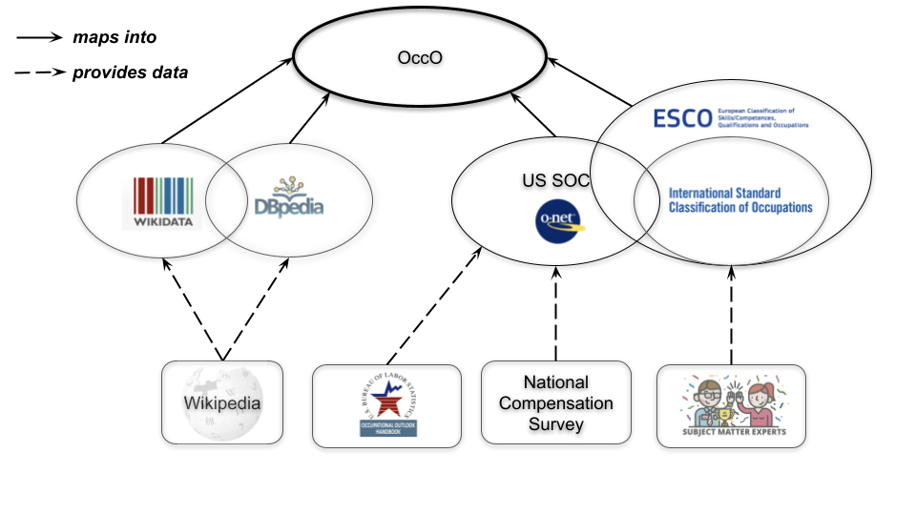
Incompleteness
One strategy for addressing the lack of full coverage emerging from NLP-driven crosswalk generation strategies...
Involves expanding the data sources
used to support ESCO and O*NET
occupation standards...
Which allows for cross-validation,
identification of gaps in coverage,
overlooked synonymous labels and
descriptions, etc.

Slide 16
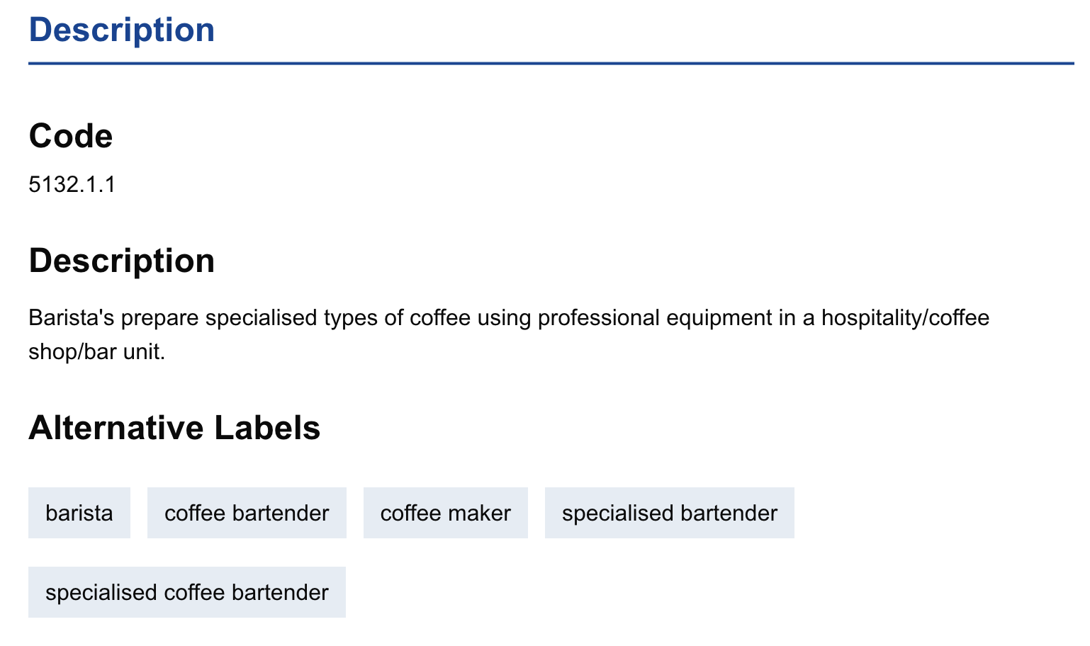
Linked Occupation Data Ecosystem
Subject-matter experts - among other sources –
inform the development of ISCO and ESCO
standards

Slide 17
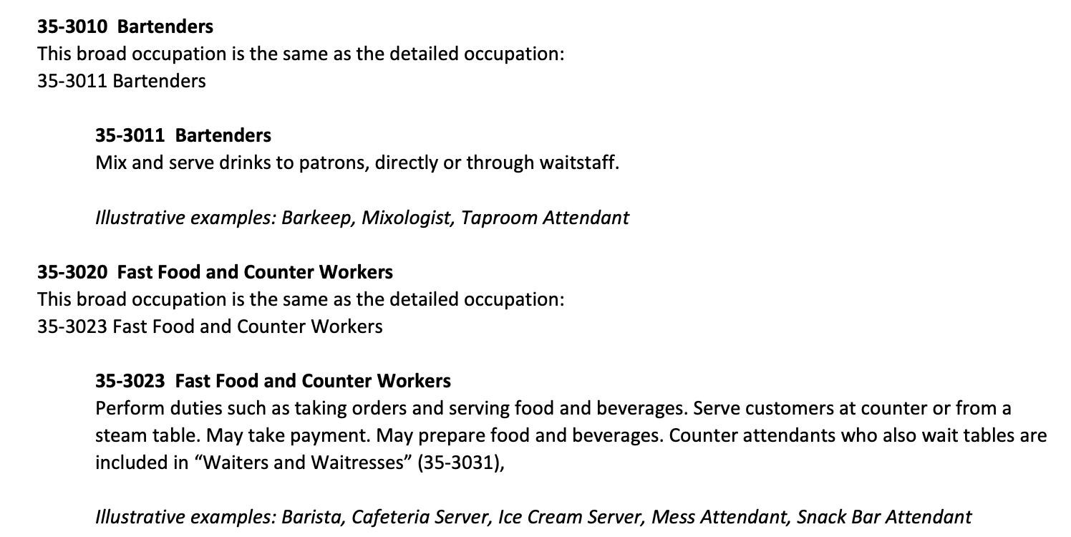
Linked Occupation Data Ecosystem
The National Compensation Survey
and Occupation Outlook Handbook
inform the development of
US SOC/O*NET

Slide 18
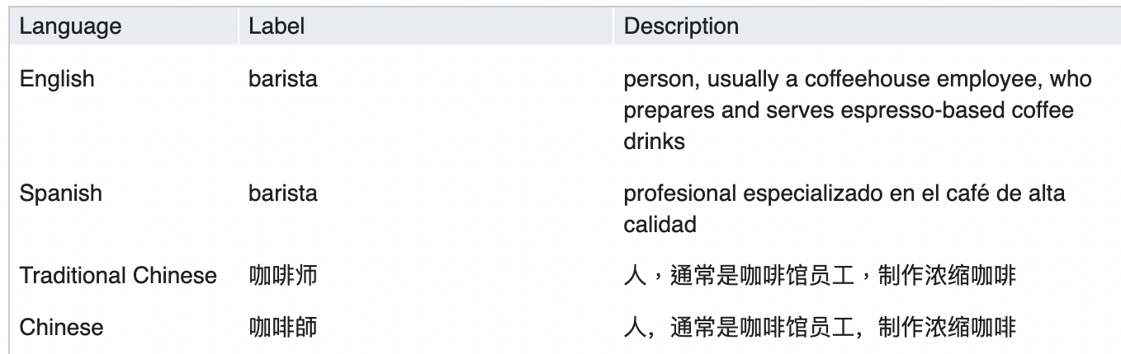
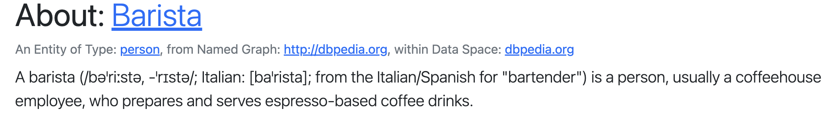
Linked Occupation Data Ecosystem
Occupation data from Wikipedia informs
Wikidata and DBPedia occupation content

Slide 19
Wikimedia
Wikidata and DBPedia are storehouses of structured occupation information, not currently being leveraged by occupation standards in these efforts
Wikidata already
represents – to
some extent –
crosswalks to ESCO
and O*NET

Slide 20
Caution: Wikidata
Wikidata allows poorly curated information to be easily added; for example, there are resources for over 10 million humans in Wikidata, many of which have few attributes (see badminton champions).
The property P106 = has-occupation lists over 17,000 occupation terms which are not instances-of Wikidata’s occupation entity Q12737077
OccO will strive to link “standard” Wikidata occupations where they exist and strive to gain Wikimedia’s interest in better curation of occupations

Slide 21
Occupation Lingua Franca
We intend the Occupation Ontology (OccO) to be used as a supplement in NLP crosswalk development to mitigate these further limitations
To that end, our OccO project has focused on:
  Mapping additional data sources beyond those used by occupation standard developers into this common language, for cross-validation

Slide 22
Occupation Lingua Franca
We intend the Occupation Ontology (OccO) to be used as a supplement in NLP crosswalk development to mitigate these further limitations
To that end, our OccO project has focused on:
  Mapping additional data sources beyond those used by occupation standard developers into this common language, for cross-validation
  Creating a semantically rich common language into which occupation standards can be mapped

Slide 23
Manual Labor
One strategy for addressing the manual curation involved in both NLP-driven and traditional crosswalk development strategies...
Involves mapping occupation standards into an ontology environment...
Capable of leveraging semantic relationships extracted from descriptions, associated skills, abilities, and expertise

Slide 24
Linked Occupation Data Ecosystem
While the Occupation Ontology is designed as a lingua franca into
which occupation standards and structured occupation data can
be mapped to promote interoperability.

Slide 26
Outline
Motivation: Linking Occupation Data
Hallmarks of Occupation
Ontological Representation of Occupation
Applications

Slide 27

Occupations as Job Title
In natural language (eng),
“occupation” is often used
synonymously with “job” or
“job title”
ISCO defines “occuption”
as involving ‘work
peformed...for an employer...’
I’ve asked several attendees “What’s your occupation” and was met with a job title every time

Slide 28
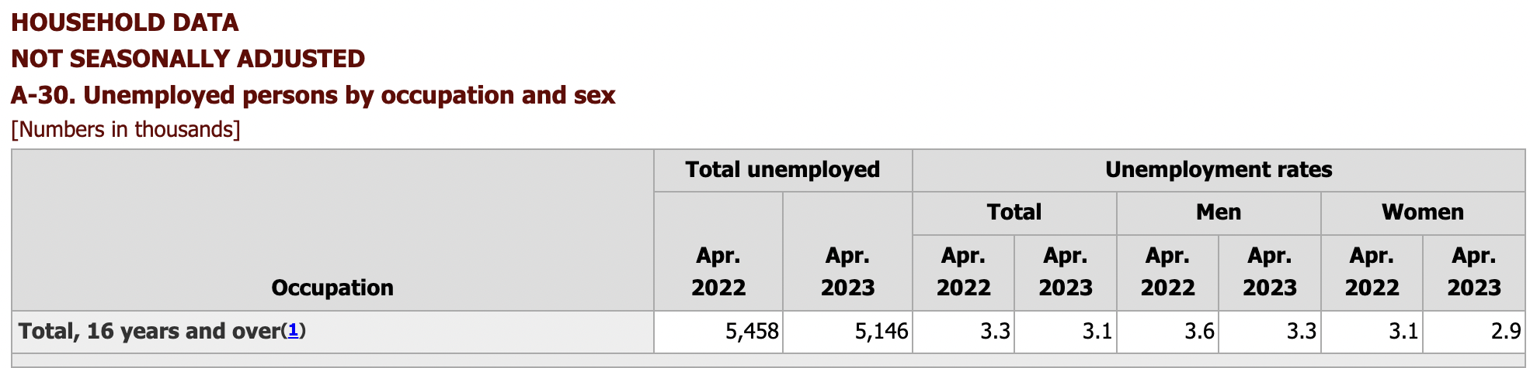
Occupations as Skills/Abilities
Similarly, “occupation” is often used to describe abilities, skills, and intent to deploy them if holding a job.
US Bureau of Labor Statistics includes a category for “unemployed persons by occupation” suggesting occupations need not be tied to a job.
A software developer
between jobs has a
developer occupation,
assuming they intend to
deploy their relevant skillset in a future job.

Slide 29
Occupations as Transactional
Employers seek individuals to fill job postings.
Unemployed individuals often seek to be employed in such postings.
If one has an occupation then one either has a job title, seeks to occupy some job title, or both.
Whether occupying or seeking to occupy, occupations are transactional

Slide 30
Hallmarks of Occupation
These observations suggest the following hallmarks of occupation:
  Occupations are ultimately transactional.
  Occupations (job title) require holders be empowered
  to perform tasks associated with that occupation.
  Occupations (abilities/skills/intent) require holders be
  capable of and intend to perform tasks associated with
  that occupation.
Which inform our ontological representation of occupation

Slide 31
Outline
Motivation: Linking Occupation Data
Hallmarks of Occupation
Ontological Representation of Occupation
Applications

Slide 32
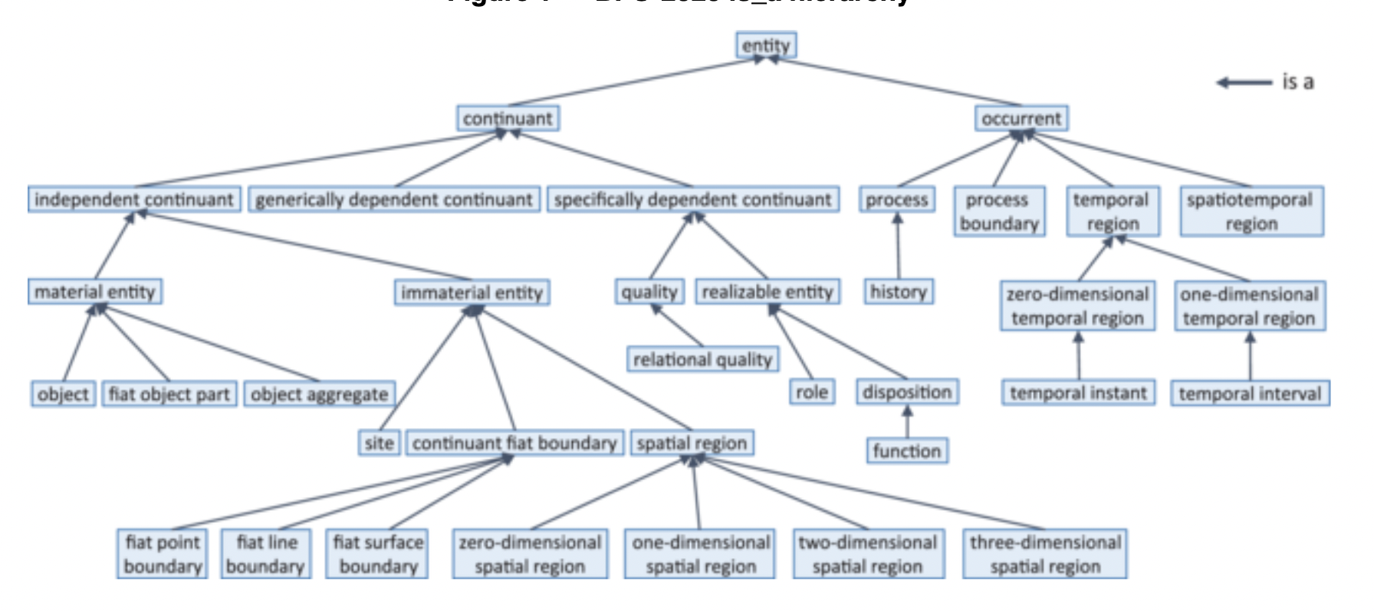
Basic Formal Ontology
Our starting point is
Basic Formal Ontology
(BFO), a top-level
ontology used
by over 500 projects,
and the only
ISO/IEC 21838
approved top-level
standard

Slide 33
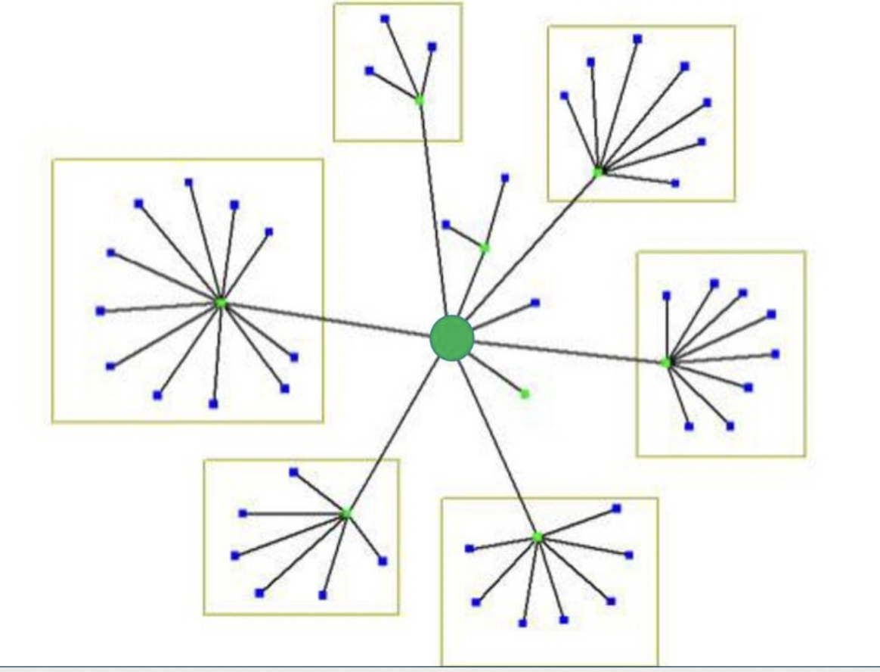
Hub & Spoke Strategy
Ontologies extending from BFO are modules in a larger hub & spoke structure
Which are extended by downward population, i.e. new classes have parent classes in a hierarchy ultimately leading to a BFO class
BFO

Slide 34
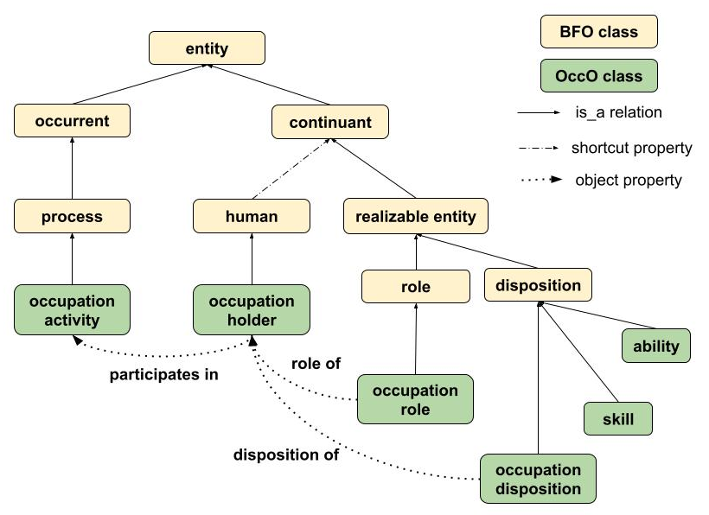
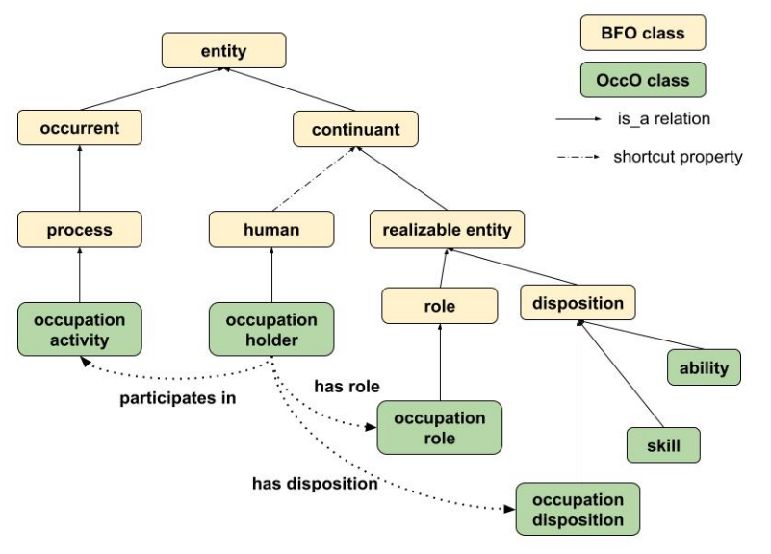
Hub & Spoke Strategy
BFO

Slide 35
The basic OccO
hierarchy as extended
from BFO, including
an intermediary class
- human – from the
NCBITaxon

Slide 36
A human bearing an occupation role or occupation disposition

Slide 37
A role borne by a human that, if realized, is realized when the bearer provides labor or
services in exchange for
compensation as
specified by some
deontic declaration.
Notes:
deontic declarations, which create, transfer, or eliminate SLGDCs or role.
Socio-Legal Generically Dependent Continuant =def. A generically dependent continuant that comes into existence through a social act and that, if it gets concretized, is concretized as a realizable entity.

Slide 38
A dispositon that, if
realized, is realized when the bearer intends to exercise abilities and
skills in pursuit of
obtaining an occupation
role.

Slide 39
A disposition that
inheres in a human,
exists in virtue of
natural biological
development, and
is such that if realized,
is realized in the
performance of one or
more tasks.

Slide 40
A disposition that exists
in virtue of training,
and is such that if
realized, is realized in
the performance of one
or more tasks with
reliably high proficiency.

Slide 41
Ability & Skill
There is a many-one relationship between abilities and skills
Developing a skill should not entail that one thereby gains a disposition of the sort naturally acquired during an individual’s development
Treating skill as a subclass of ability would run the risk of suggesting that for every skill there is some ability that was trained into that skill, which is false. One does not become an expert programmer by training up a native programming ability.

Slide 42
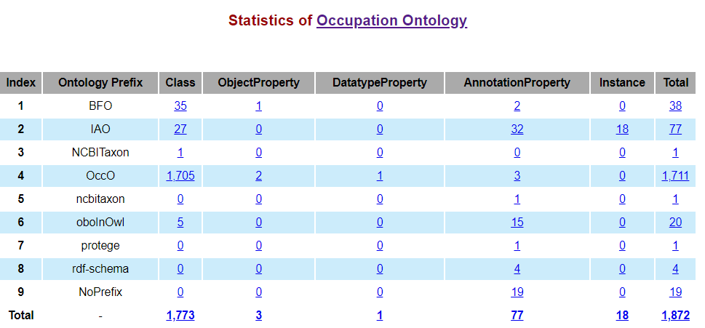
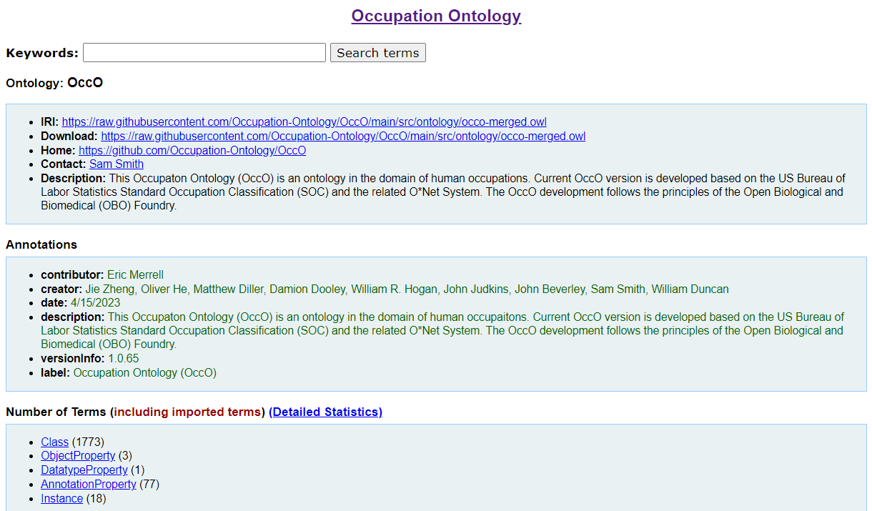
OccO Descriptive Statistics
  1,872 terms so far
  Class (1773)
  ObjectProperty (3)
  DatatypeProperty (1)
  AnnotationProperty (77)
  Instance (18)
GitHub: https://github.com/Occupation-Ontology/OccO
Ontobee: https://ontobee.org/ontology/OccO
Notes:
https://ontobee.org/ontostat/OccO
https://ontobee.org/ontology/OccO

Slide 43
Outline
Motivation: Linking Occupation Data
Hallmarks of Occupation
Ontological Representation of Occupation
Applications

Slide 44

Outline
Motivation: Linking Occupation Data
Hallmarks of Occupation
Ontological Representation of Occupation
Applications

Slide 45
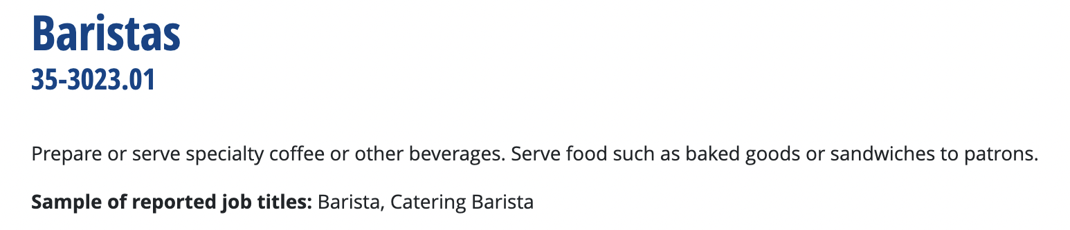
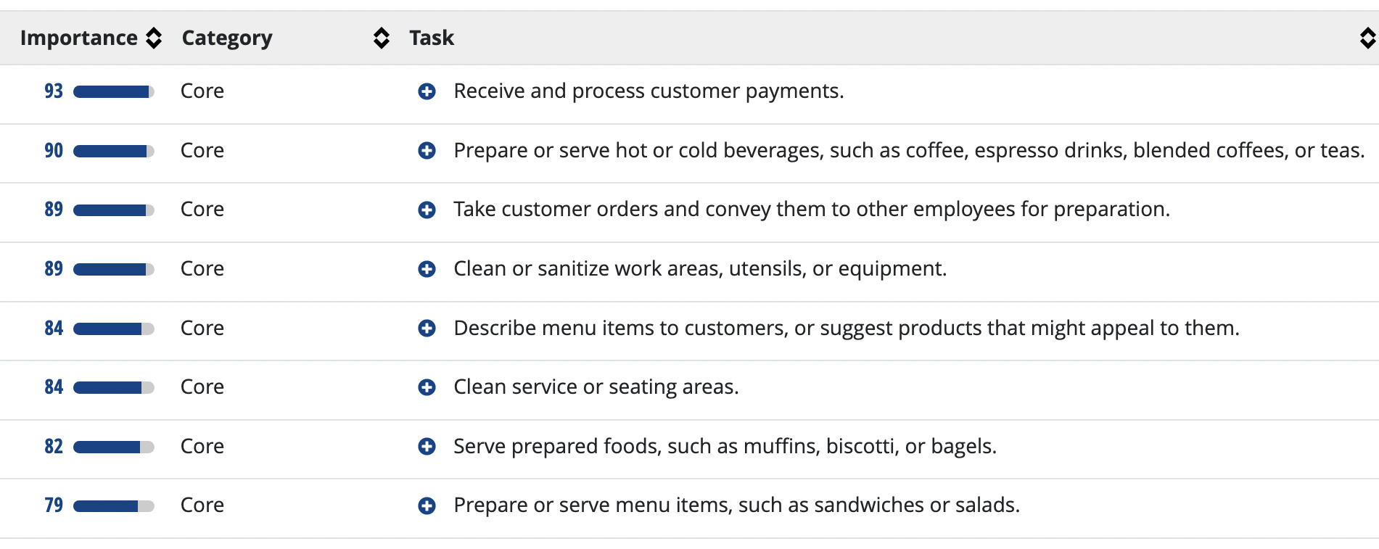
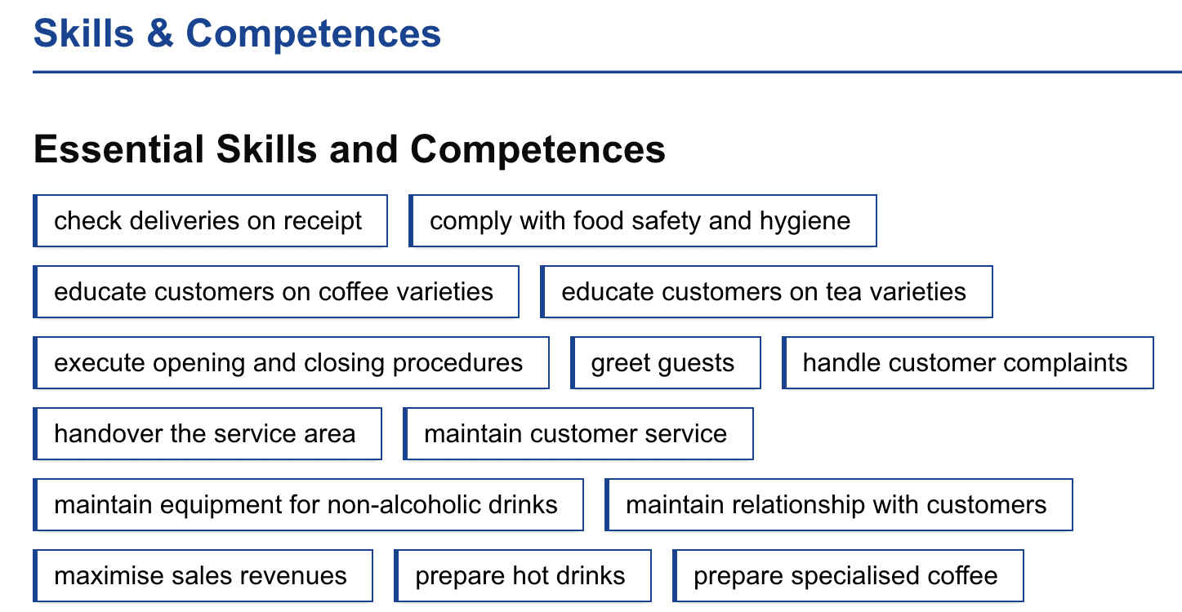
Skills, Competencies, Tasks
Occupation standards include more than just labels and descriptions
They additionally include data
concerning occupation specific
tasks, skills, competencies, etc.

Slide 46
CCO, IOF, OBO, UToronto
“Work smarter, not harder”
- No need to look up the source
We’ll leverage occupation classes from the many ontologies developed in conformance with BFO; reuse saves work
We’ll leverage Maryam Fazel-Zarandi’s (formerly of UT) work on skills and competency, with thanks to M&M (Megan Katsumi & Mark Fox)

Slide 47
Two Dispositions
Much like skills result from training of multiple abilities, expertise is plausibly the training of multiple skills and abilities
In other words, there is a many-one relationship between skill and expertise, much like the many-one relationship between ability and skill
On the other hand, abilities are ‘innate’ dispositions while expertise appears ‘innate’, i.e. expert tennis player doesn’t deliberate, they just swing...

Slide 48
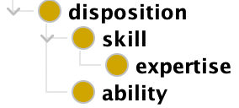
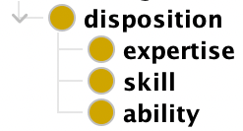
Two Options
Option 1
Expertise is skill that becomes innate
When one bears an instance of expertise it is also an instance of skill
Option 2
‘Innate’ aspects of expertise and ability are not reflected in the hierarchy
When one bears an instance of expertise, it is not thereby an instance of skill

Slide 49
Invitation to Help
What exactly is the relationship between ability and skill?
What exactly is the relationship between skill and expertise?
How best to characterize the ‘innate’ nature of expertise, as contrasted with the ‘innate’ nature of ability?

Slide 50
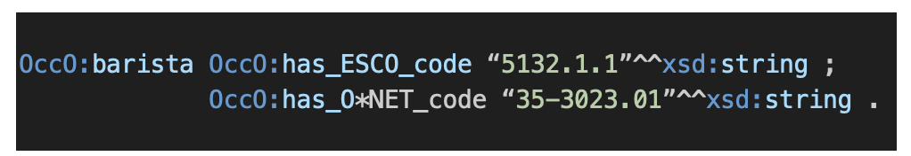
has_XYZ_code
To connect occupation standards within OccO, we use datatype
properties linking occupation codes to OccO terms
For example, ‘barista’ is represented in ESCO and O*NET and considered to be an “exact match” between them

Slide 51
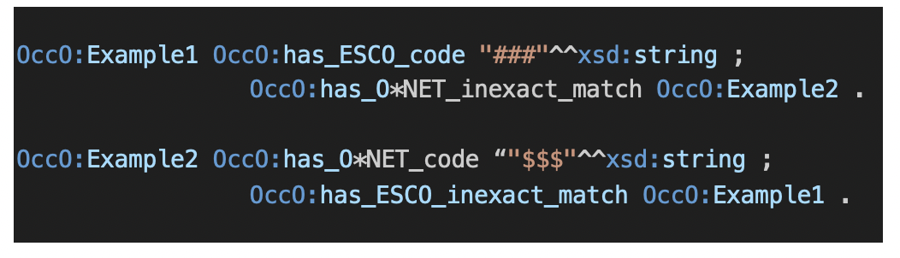
has_XYZ_inexact_match
For so-called “inexact matches” we connect a given occupation code to an OccO class using an object proprty to indicate it has an inexact match with respect to the relevant occupation standards

Slide 52



