Slide 1
Issue #56 Support of system models with bus communication
MAP-SSP Meeting, March 10th, 2025

Slide 2
Challenge / Vision

Slide 3
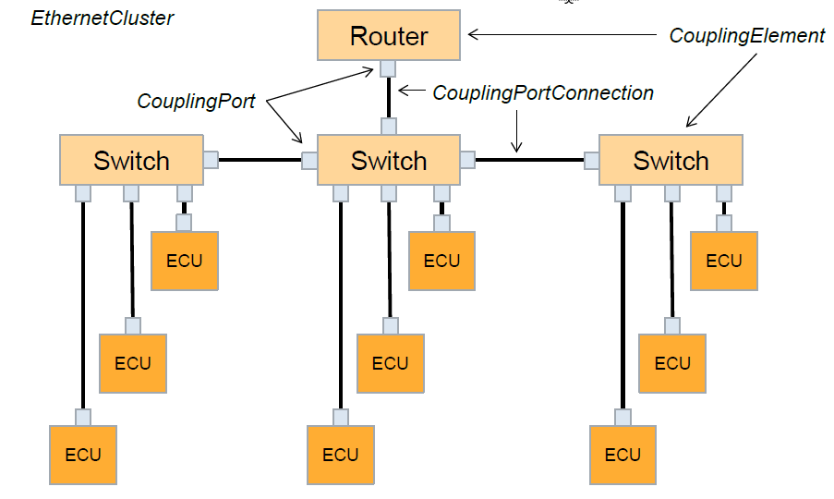
Typical Bus Topologies
2 channels per cluster.
NodeB
NodeA
NodeB (Gateway)
NodeC
NodeA
NodeC
ChannelA
ChannelB
CanChannel
Exactly 1 channel per CAN cluster.
All participants must have the same bus protocol and baud rate.
Exactly 1 Channel per LIN Cluster
Different roles of the participants
NodeA Master
LinChannel
NodeB Slave
NodeC Slave
1..* channels per cluster
Coupling elements are transparent for data,
BUT, important for bus timing/performance.

Slide 4
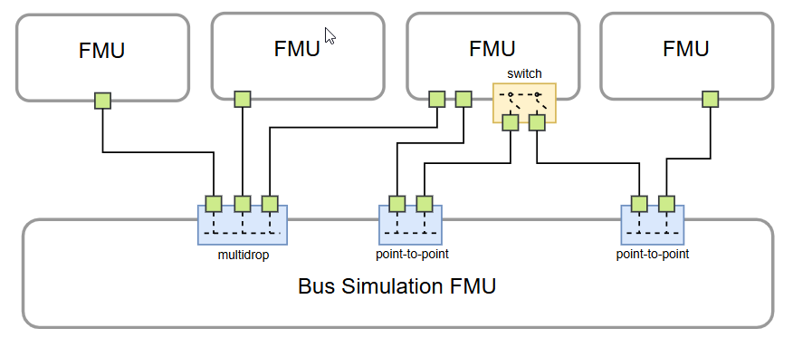
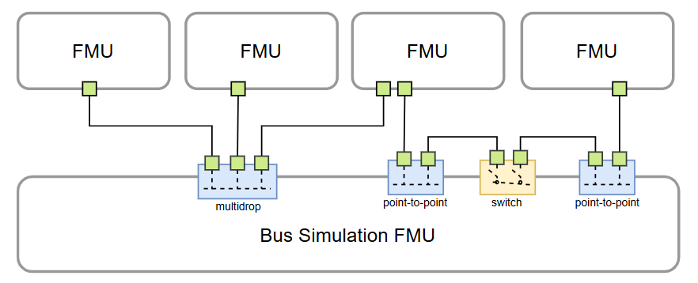
Ethernet Topologies (from draft FMI LS Bus)
Need to support mulitidrop segments.
Need to support point-to-point segments.
Component
Component
Component
Component
Switch modeled inside component
Bus Simulation Component or Importer with Bus Support
Component
Component
Component
Component
Switch modeled inside Bus Simulation
Bus Simulation Component or Importer with Bus Support

Slide 5
Hierachical systems with buses
Merged System
S
A
System Model
S
A
B
Referenced SSPs
B
Recursive replacement of referenced SSPs
C
B
D
C
D
Clusters may be connected over multiple system levels.
It must be possible to delegate CommunicationConnectors.
The bus type and baudrate must not be conflicting.

Slide 6
Goals for the Bus Support in SSP
Support for typical bus types, like CAN, LIN, Ethernet, FlexRay.
It is not necessary to describe the details of the bus. Mainly the interconnection of components in one or more communication clusters (buses) has to be described in SSP.
Support for different types of components accessing the bus.
FMUs with fmi-ls-bus
Other vendor-specific formats (having special CommunicationConnectors for accessing a bus, i.e. not based on fmi-ls-bus).
Hierarchical systems with network communication.
Use Case 1: Nested SSP subsystem with local CommunicationCluster.
Use Case 2: Common CommunicationCluster accessed from multiple system levels, i.e. from components in the top-level system and also from components in inner subsystems.
Some basic validations of the network structure should be possible.
For example, "Same bus type and baud rate for all components in a cluster".

Slide 7
Terminology
The terms
Communication Cluster
Communication Channel
Communication Connector
are widely used in automotive industry, for example by AUTOSAR and ASAM Fibex.
It makes sense that SSP adopts this terms.
Communication Connector
Communication Connector
CommunicationChannel
CommunicationCluster

Slide 8
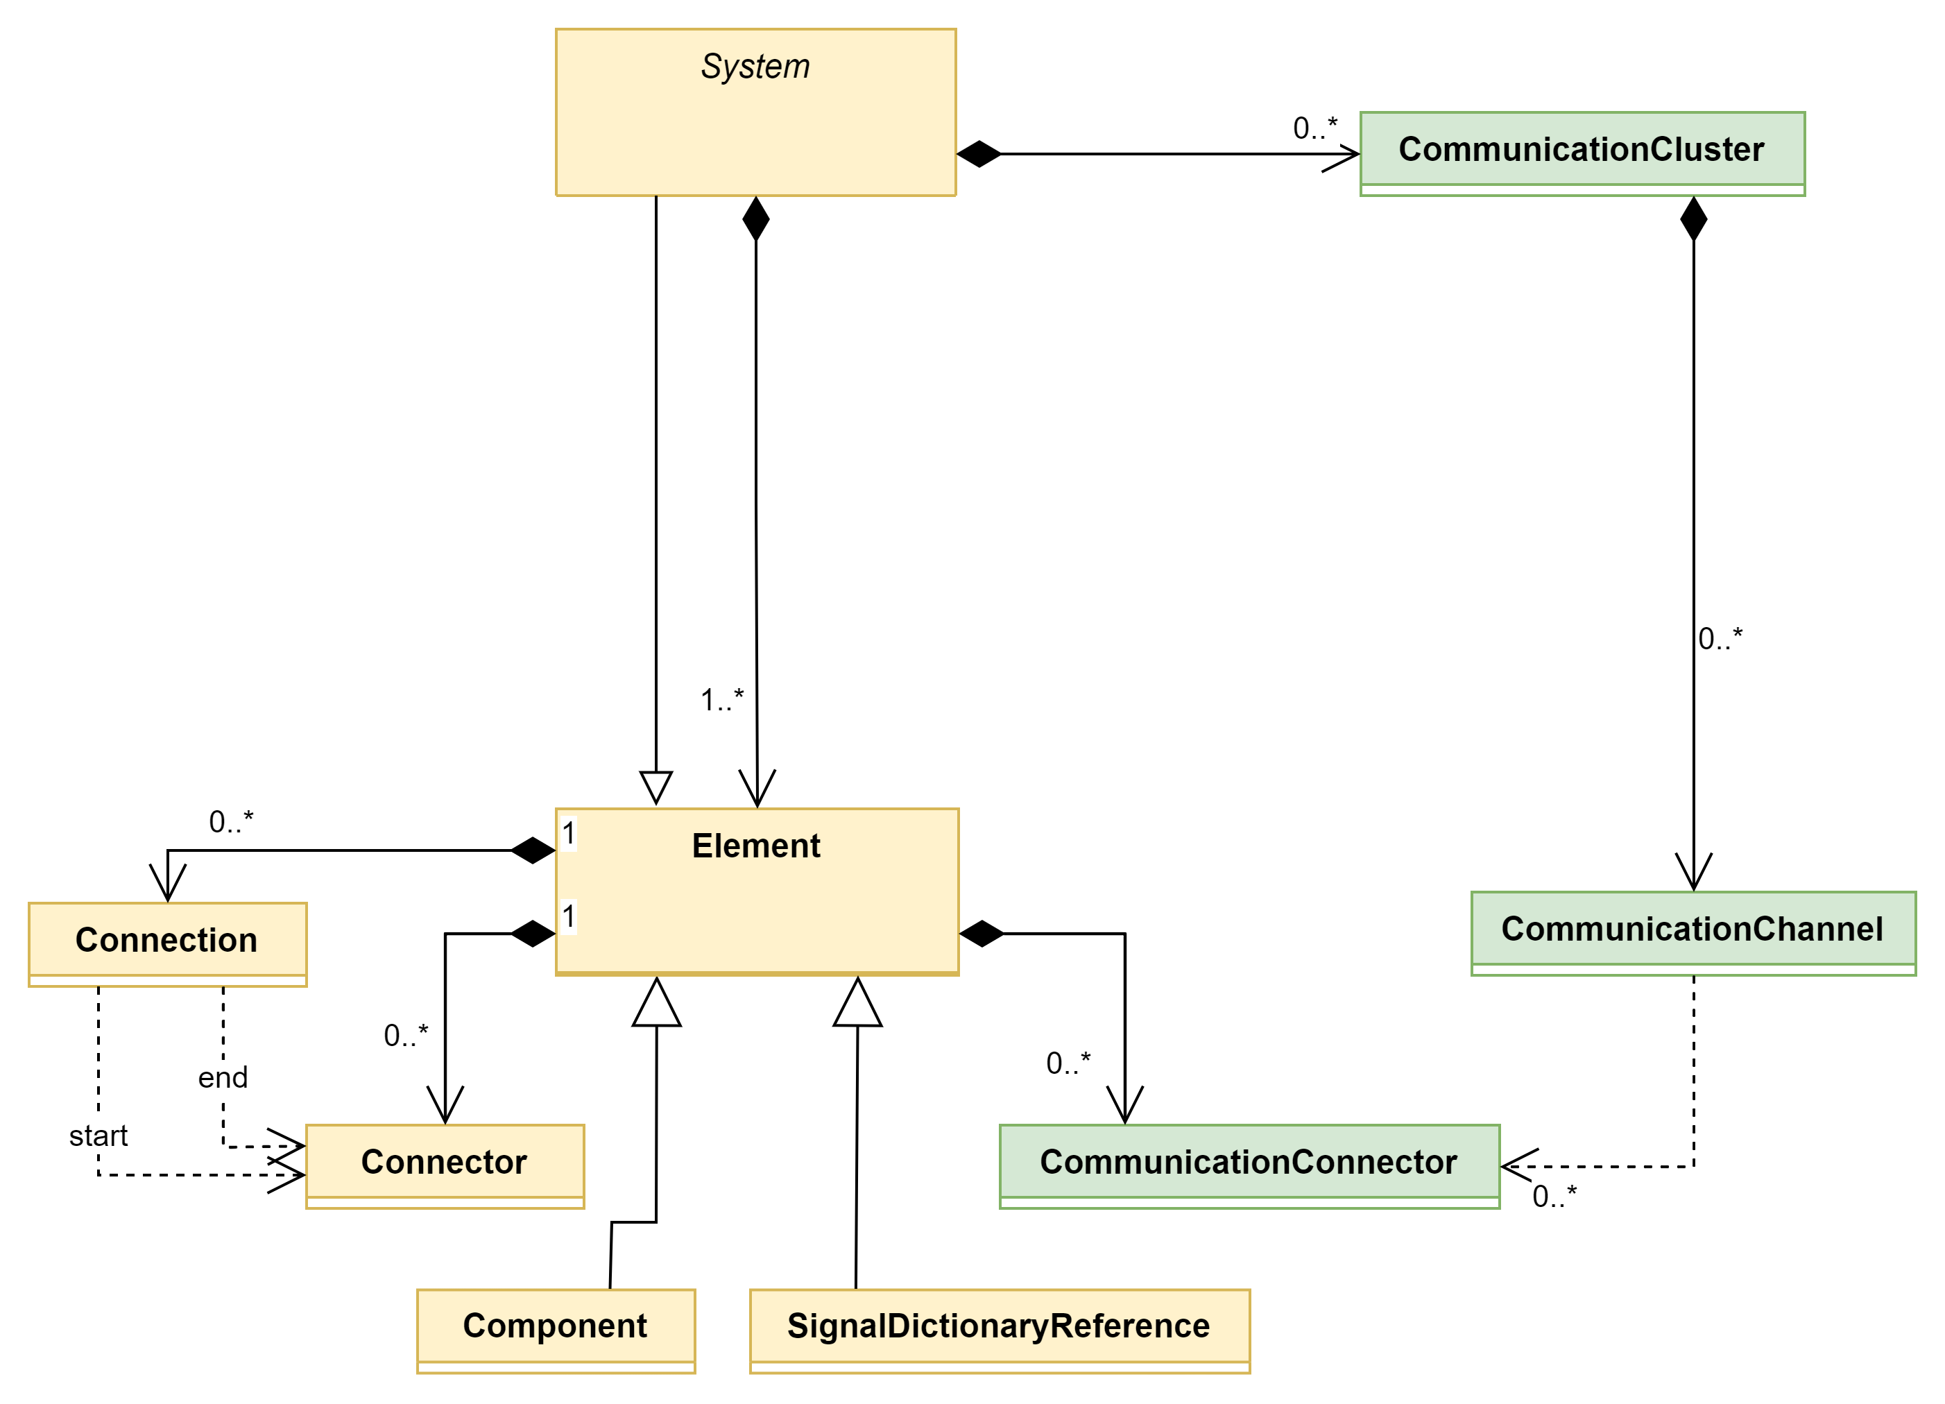
Possible SSP Extension (without Coupling elements)
Bus description could be serialized using Terminals & Icons?

Slide 9
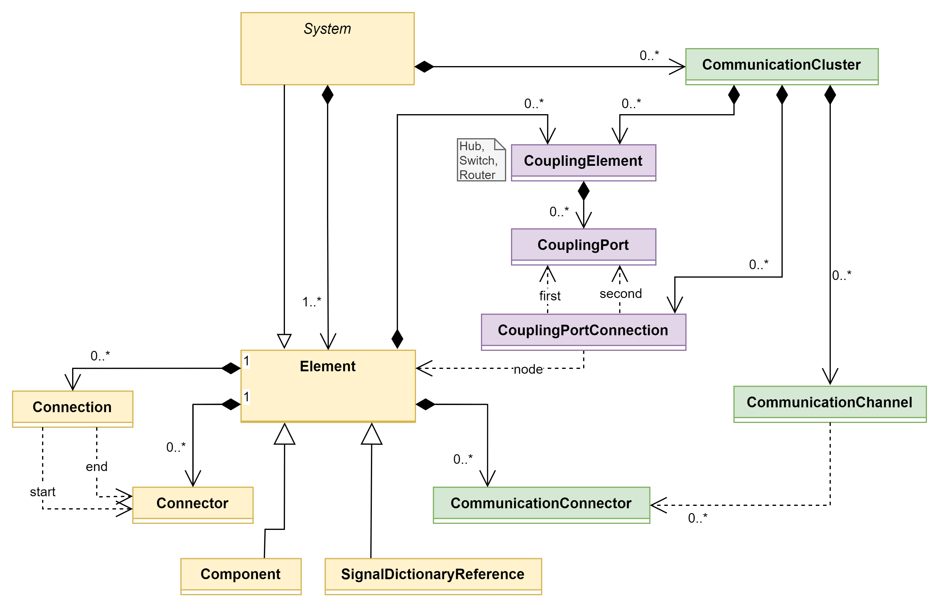
Possible SSP Extension (with Coupling Elements)
Bus description could be serialized using Terminals & Icons?

Slide 10
Backup

Slide 11
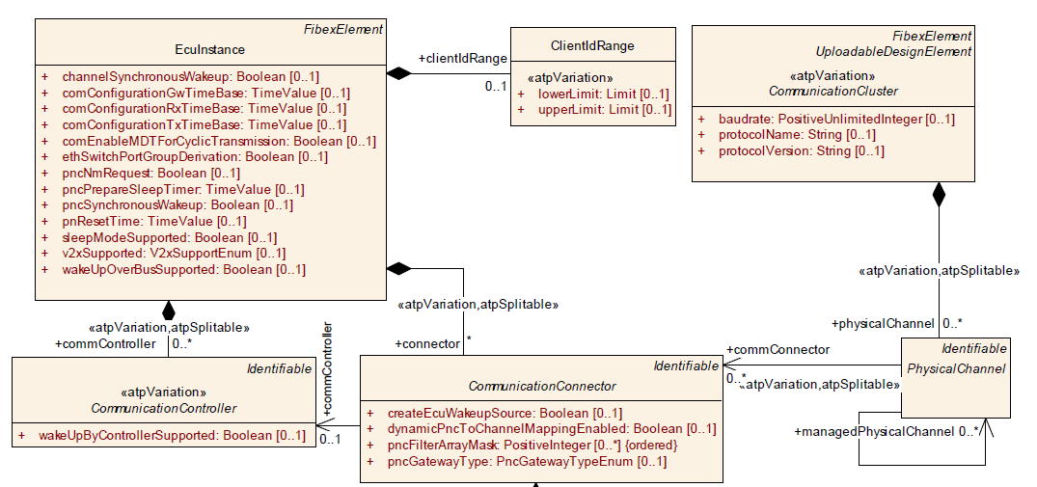
AUTOSAR Meta Model for Communication Clusters

Slide 12
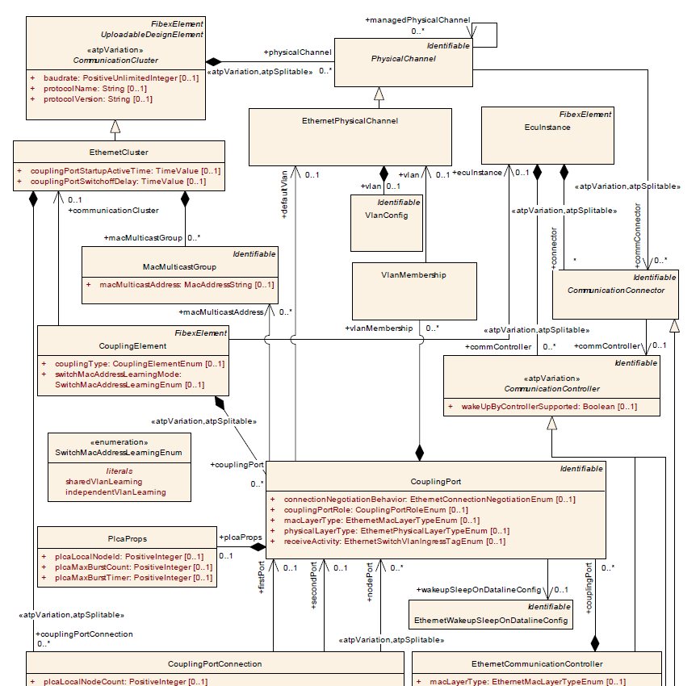

Slide 13
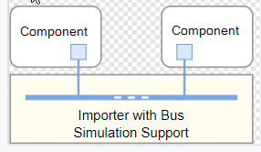
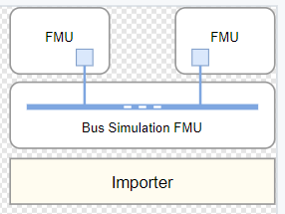
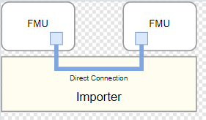
FMI LS Bus

